Slide 1
Talking Fingers
PIP2001 Capstone Project
Review-5
Batch Number:
Under the Supervision of,
Ms. Josephine R
Assistant Professor
School of Computer Science and Engineering
Presidency University
Roll Number | Student Name
20211CAI0033 20211CAI0029 20211CAI0073 20211CAI0178 | ABI ROSHAN MUHAMMAD HASNAIN PRANAV PRADEEP HUZAIFA FATHIMA
Name of the Program: B.Tech
Name of the HoD: Zafar Ali Khan
Name of the Program Project Coordinator: Dr. Afroz Pasha
Name of the School Project Coordinators: Dr. Sampath A K / Dr. Abdul Khadar A / Mr. Md Ziaur Rahman

Slide 2
Introduction
This presentation proposes a translation model designed to address the significant challenges faced by deaf-mute individuals in India, including limited access to education, employment, and communication. The platform aims to bridge this gap by providing a user-friendly and time-efficient tool for learning Indian Sign Language (ISL) and facilitating effective communication. By offering a self-learning platform, the proposal seeks to empower deaf-mute individuals and reduce their reliance on limited resources, especially in rural areas.

Slide 3
Literature Review
Existing Systems for Speech-to-Sign Translation
TESSA (Speech-to-BSL System): One of the early systems designed to translate speech into British Sign Language (BSL) in specific domains, like post-office services. The system relied on pre-determined phrases, which limited its application to specific scenarios.[2]
ViSiCAST (BSL Translation System): A more advanced system translating spoken English into BSL, it used a syntactic parser and incorporated sign language grammar through HamNoSys notation. It was part of a broader effort to improve accessibility for the hearing-impaired in public service settings​.[3]
INGIT (Hindi-to-ISL Translator): INGIT is a limited-domain Hindi-to-ISL translation system used for railway reservations. It uses HamNoSys notation and sign language gloss, but its limitation lies in the lack of a robust ISL corpus​.[1]
SignSynth (ASCII-Stokoe Model for ASL): Developed in 1999, this system uses ASCII-Stokoe notation for representing ASL signs. It translates text into ASL animations but lacks real-time speech recognition.

Slide 4
Literature Review
Speech-to-ISL Translators
Recent efforts have focused on translating speech to ISL using NLP techniques. Dasgupta et al. proposed a system that converts English text to ISL structure, but it struggled with handling the unique syntax of ISL.
The Speech-to-ISL Translator by Jadhav et al. (2021) demonstrates the combination of microphone input with sign language videos. This system uses PyAudio for speech input and Google Speech API for speech-to-text conversion, but it faces challenges in maintaining accuracy and handling noisy input.
Automated Speech to ISL Conversion (Bharati et al.): This system uses Google’s API for speech recognition and NLP techniques to remove unnecessary parts of speech, transforming the input text into sign language videos. However, like many other systems, it does not fully account for ISL's unique grammar rules.

Slide 5
Existing method Drawback
Inadequate ISL Syntax Processing
Many systems fail to properly convert spoken language into ISL’s unique syntax, which follows a subject-object-verb structure, unlike English’s subject-verb-object pattern.
Limited ISL Resources
There is a lack of robust ISL datasets and video libraries. Current systems often rely on web-scraping for ISL videos, leading to inconsistent quality and coverage​.
High Latency and Accuracy Challenges
Systems like INGIT and others suffer from processing delays, especially when translating longer sentences, reducing usability for real-time applications. Furthermore, noise in speech inputs can affect translation accuracy.

Slide 6
Proposed Method
Speech Recognition: Converts spoken English into text.
NLP: Processes text, generates ISL syntax.
YouTube Video clip retrieval: Retrieve the corresponding video clips and merge.
Error Handling: Reduces delays and improves accuracy.

Slide 7
Objectives
Develop a Speech-to-ISL Translation System
Convert spoken English into ISL with proper syntax handling.
Enhance Translation Accuracy and Minimize Latency
Improve translation speed and accuracy by optimizing noise removal, speech recognition, and video merging techniques.
Create an Educational Tool for ISL Learning
Design the system to serve as an educational platform where users can learn ISL through interactive and intuitive video outputs​(Speech_to_Indian_Sign_Language).
Provide an Accessible and User-Friendly Interface
Develop a web-based interface that can be used by individuals with varying technical skills, ensuring ease of access for both hearing and hearing-impaired users​

Slide 8
Methodology/Modules
Speech Recognition Module
Uses Python’s Speech Recognition module to capture and convert spoken input into text​.
Natural Language Processing (NLP) Module
The NLP engine performs tokenization, parsing, lemmatization, and ISL syntax generation. It removes stop words and adjusts tenses to match ISL grammar​
Error Handling and Optimization
The system reduces delays by translating partial speech results, allowing for quicker ISL video generation. Noise removal techniques are implemented to ensure clarity in speech recognition​.

Slide 9
Architecture
Speech Input
Generated ISL Syntax
retrieving respective video clips from YouTube
merge the clips to form a meaningful response
Final Result
Modify Parse Structure
Speech To Text
Lemmatizing
Filter Stop Words

Slide 10
Hardware/software components
Software requirements:
Python (Google Colab)
Natural Language Processing libraries (e.g., TensorFlow Lite, NLTK, YTDLP)
Deep Learning frameworks (e.g., TensorFlow, PyTorch)
Version control system (e.g., Git)
Text editor (e.g., Visual Studio Code)

Slide 11
Hardware/software components
Hardware requirements:
Computer with sufficient processing power and RAM
Microphone (for speech input)

Slide 12
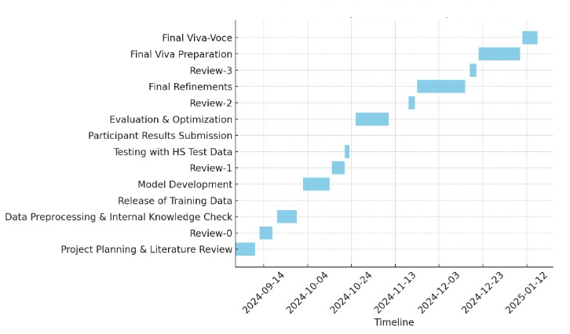
Timeline of Project

Slide 13
Results and Outcomes
Broader Access to Information: The proposed online platform will significantly expand the opportunities for deaf-mute individuals to access a wide array of information and knowledge. By overcoming traditional barriers to communication, it will provide them with a more inclusive and equitable avenue for staying informed and engaged. This access is particularly important for their personal development and social integration.
Enhanced Communication Opportunities: The platform is designed to serve as a bridge between deaf-mute individuals and those who can hear. By offering tools that facilitate seamless interaction, it will enable more effective communication, fostering better understanding and collaboration between these groups. This improvement in communication will help reduce misunderstandings and strengthen social bonds.
Advancements in Education: For deaf-mute students, the platform will be a critical resource for learning Indian Sign Language (ISL) and improving their overall educational experiences. By providing an interactive and accessible way to acquire knowledge, it will support their academic growth and help address the significant gaps in traditional educational resources available to them.
Empowering the Deaf-Mute Community: Through the provision of a self-learning platform, this initiative aims to empower individuals within the deaf-mute community to take charge of their education and skill development. By fostering greater independence, it will reduce their dependence on the limited resources currently available, allowing them to participate more fully in various aspects of society and lead more self-sufficient lives.

Slide 14
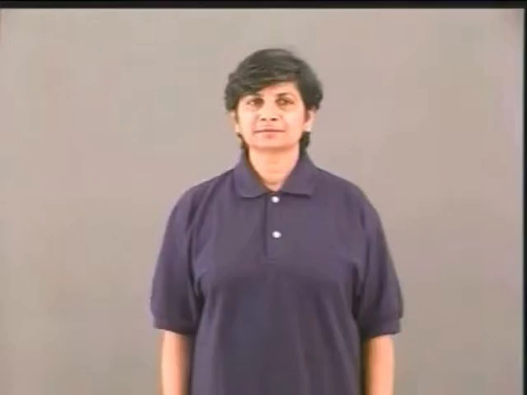
Output

Slide 15
Conclusion
The proposed translation model offers a promising solution to address the significant challenges faced by deaf-mute individuals in India. By providing a user-friendly and accessible tool for learning ISL and facilitating communication, the platform has the potential to significantly improve the quality of life for deaf-mute individuals and promote social inclusion. Future research and development efforts can further enhance the platform's capabilities and expand its reach to a wider audience.

Slide 16
References
[1] Tirthankar Dasgupta, Sandipan Dandpat, and Anupam Basu. “Prototype Machine Translation System From Text-To-Indian Sign Language”, 2008 Asian Federation of Natural language Processing, ACM Digital Library, pp 19-26
[2] Stephen Cox et al. “TESSA, a system to aid communication with deaf people”, Assets '02: Proceedings of the fifth international ACM conference on Assistive technologies, July 2002 Pages 205–212
[3] Alisha Kulkarni , Archith Vinod Kariyal, Dhanush V, Paras Nath Singh. “Speech to Indian Sign Language Translator”, Proceedings of the 3rd International Conference on Integrated Intelligent ComputingCommunication & Security (ICIIC 2021)
[4] Kajal Jadhav, Shubham Gangdhar, Viraj Ghanekar. “SPEECH TO ISL (INDIAN SIGN LANGUAGE) TRANSLATOR”International Research Journal of Engineering and Technology (IRJET) | Apr 2021
[5] Ritika Bharati et al. “Automated Speech to Sign language Conversion using Google API and NLP”, Proceedings of the International Conference on Advances in Electronics, Electrical & Computational Intelligence (ICAEEC) 2019, Elsevier

Slide 17
Github Link
https://github.com/hazmhk

Slide 18
Project work mapping with SDG
SDG 3 - Good Health and Well-Being: Enhancing accessibility for individuals with hearing impairments supports their mental health and well-being by promoting inclusion and reducing isolation.
SDG 4 - Quality Education: Our project can help improve education for deaf individuals by enabling better communication and access to information.
SDG 8 - Decent Work and Economic Growth: Enhancing communication can create more inclusive work environments, providing equal opportunities for deaf individuals.
SDG 10 - Reduced Inequalities: Your project directly addresses inequality by empowering deaf individuals and fostering inclusivity.
SDG 11 - Sustainable Cities and Communities: Bridging communication gaps contributes to building inclusive communities.

Slide 19
Thank You

